Slide 1

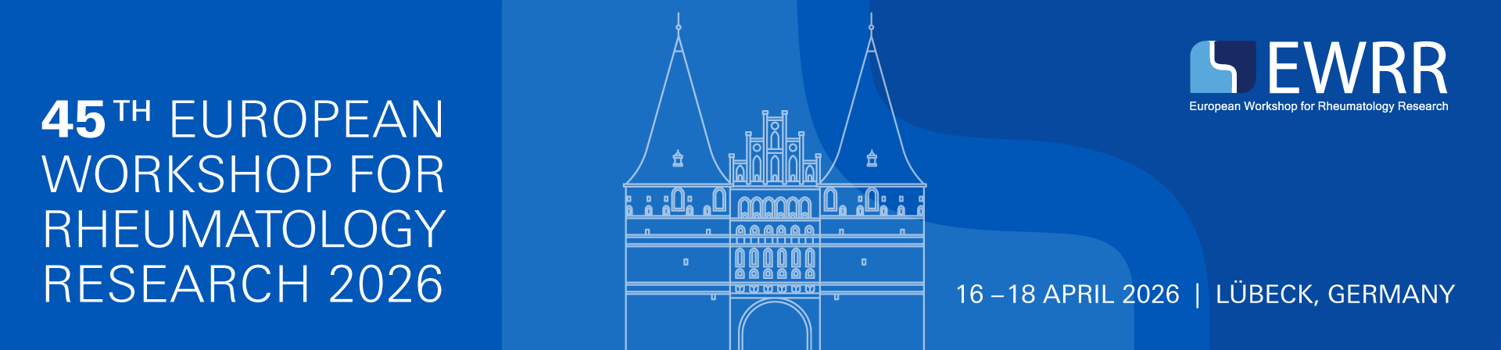


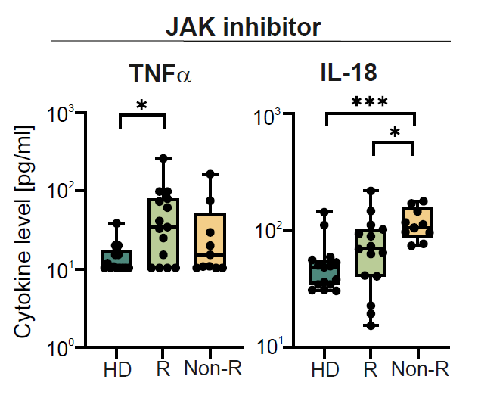
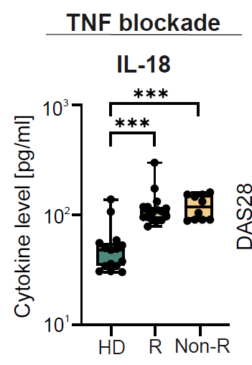
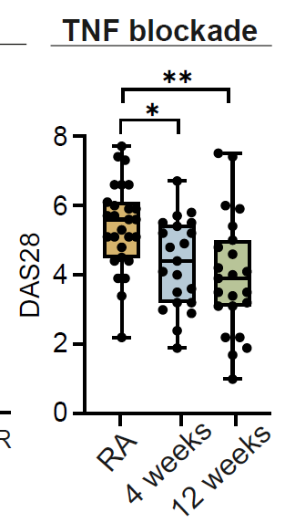
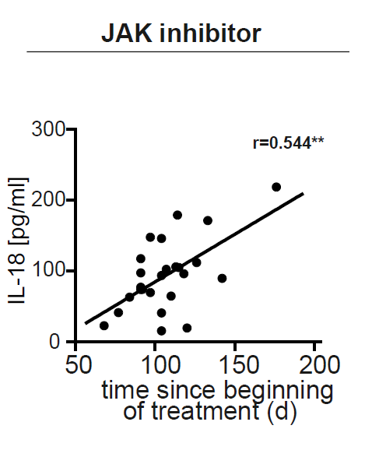
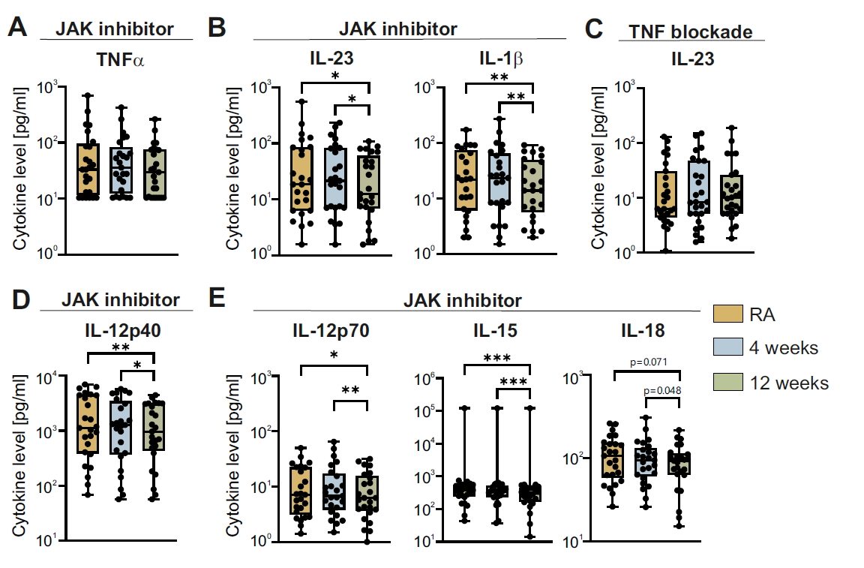
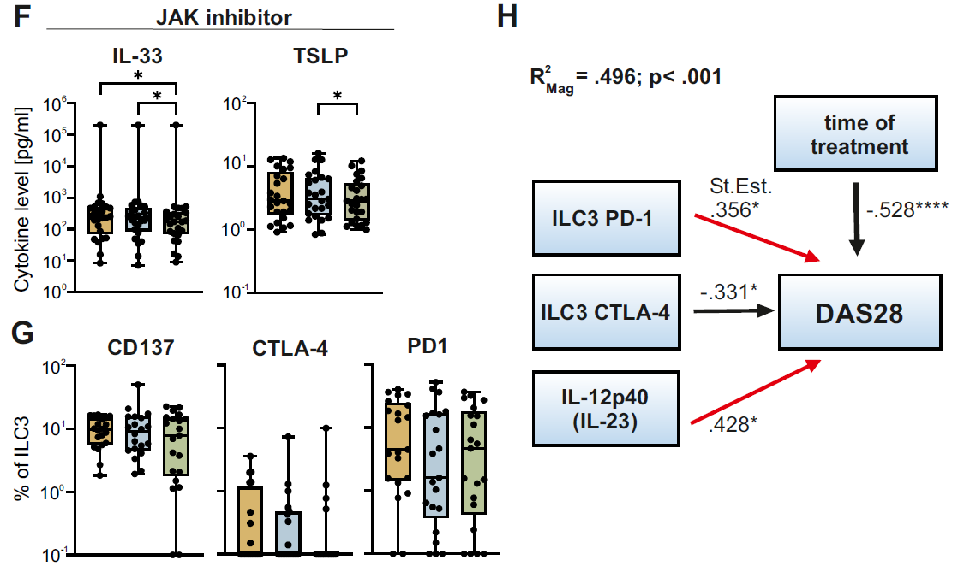
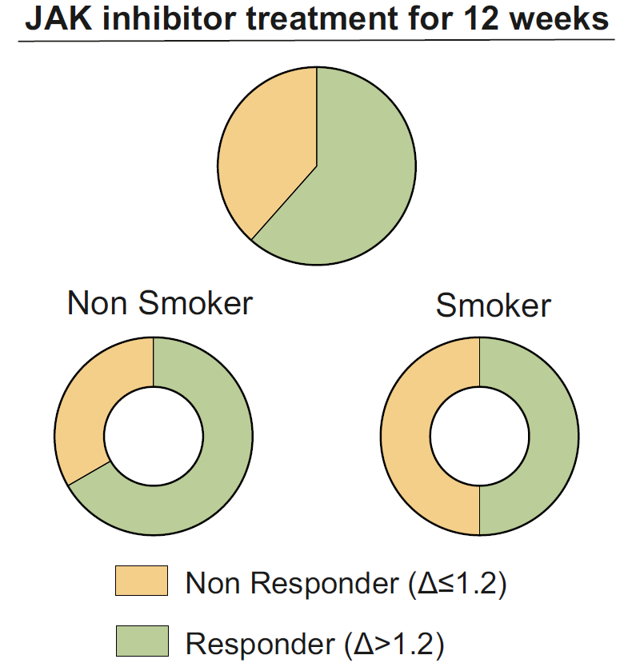
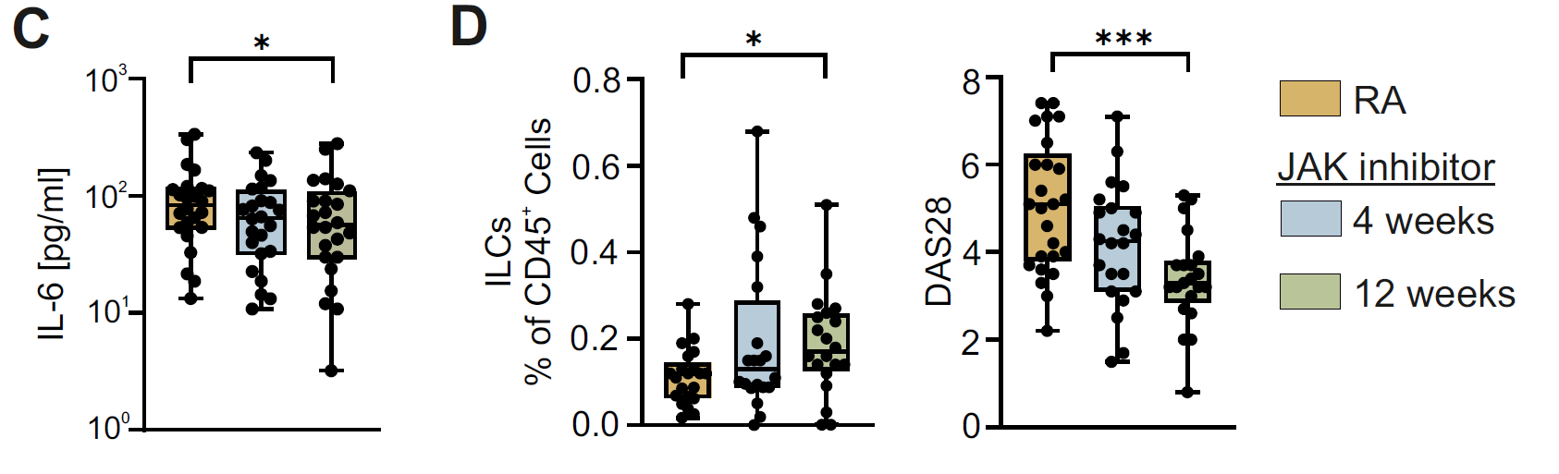
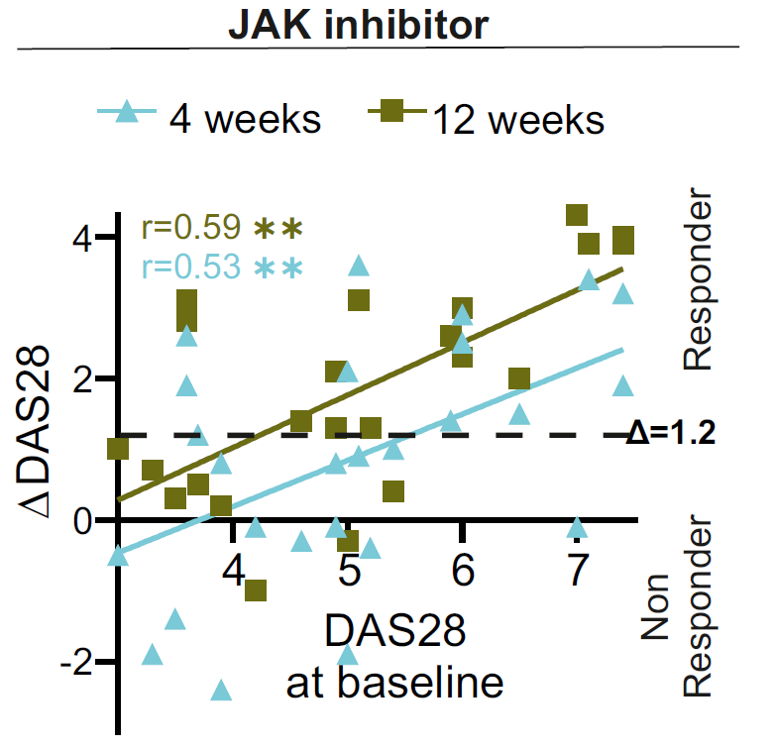
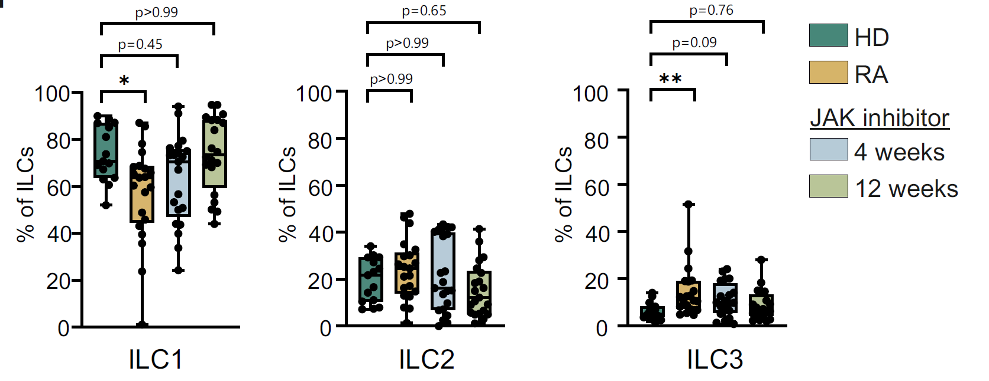
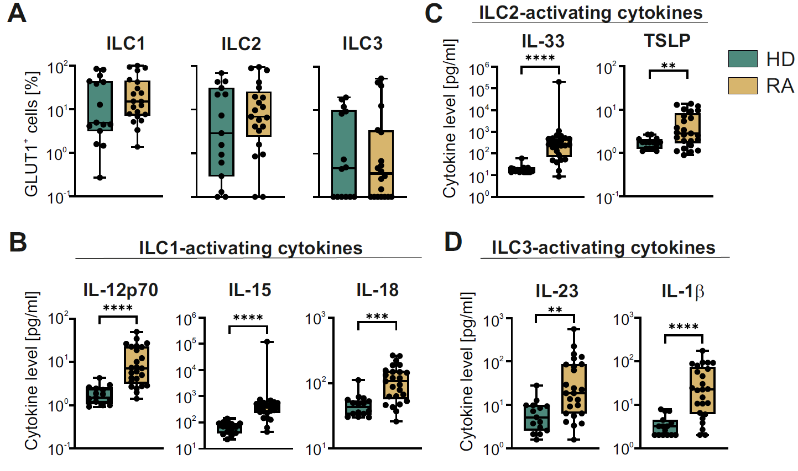
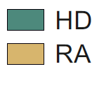

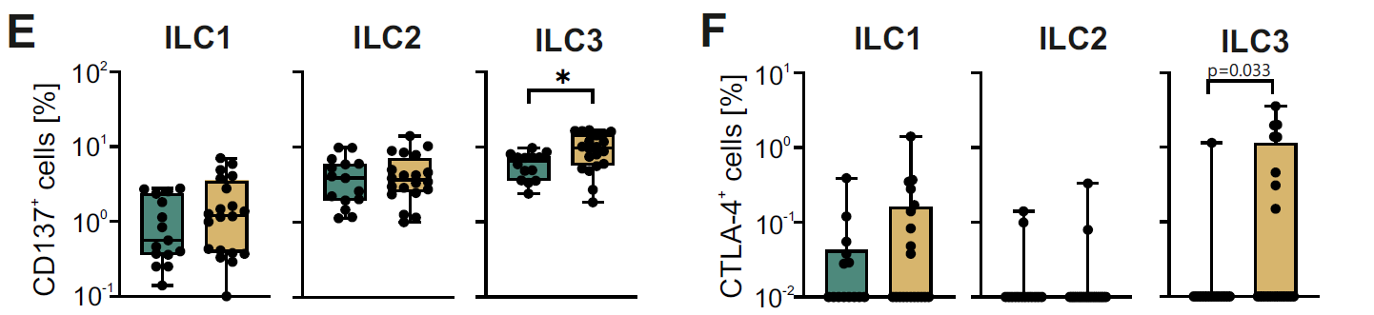
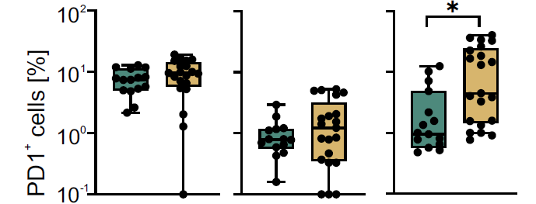
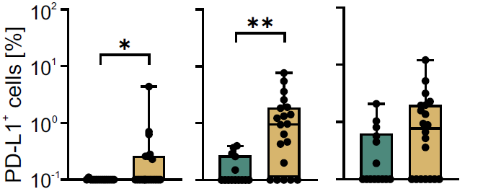
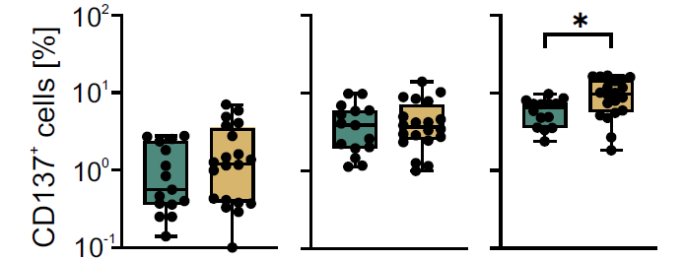
Katrin Vogel, Michelle Kraft, Aditya Arra, Irina Han, Thomas Häupl, Eugen Feist and Monika C. Brunner-Weinzierl
Contact:
Prof. Dr. M.C. Brunner-Weinzierl
monika.brunner-weinzierl@med.ovgu.de
http://expae.med.ovgu.de
JAK-independent IL-18 escape during baricitinib therapy in rheumatoid arthritis (RA)
Department of Experimental Paediatrics
Background
JAK1/2 inhibition primarily targets cytokine pathways that signal via JAK/STAT.
We investigated whether residual inflammation under baricitinib treatment could shift towards JAK-independent receptor signalling cytokines, indicating an escape axis in a subset of patients.
Materials and Methods
We analysed a real-world longitudinal RA cohort (n=60) initiating baricitinib (n=29) or TNF inhibitors (n=31). Serum cytokines covering JAK-dependent and JAK-independent signalling were quantified by multiplex bead-based flow cytometry at baseline, week 4, and week 12. Additional analyses included patients with >50 days of JAKi exposure. Limited response was defined as ΔDAS28 <1.2.
Results
IL-18 identifies JAK-independent escape in baricitinib non-responders
Baricitinib suppresses JAK-dependent cytokine circuits
A
B
C
D
Fig. 1 IL-18 was elevated in baricitinib non-responders, increased with treatment duration, and did not discriminate responders from non-responders under TNF inhibitor therapy.
Baricitinib improves disease activity and reshapes ILC composition
A
C
D
Fig. 3 DAS28 improved under baricitinib and was accompanied by a shift in peripheral ILC composition.
B
E
Fig. 2 JAK-dependent cytokine pathways, including the IL12p40/IL-23 axis, declined under baricitinib.
Conclusion
A mechanistically pre-specified JAK-dependent vs JAK-independent framework identified a JAK-independent escape signature during baricitinib therapy.
This signature is characterised by rising IL-18 and persistent TNFα.
Monitoring IL-18 may support earlier pathway-adaptive treatment strategies.
Baseline innate cytokine and ILC activation context in RA
A
B
Fig. 4 At baseline, RA was characterised by elevated innate cytokines and altered ILC-associated marker expression compared with healthy controls.
C
Mechanistic interpretation
Baricitinib suppresses JAK-dependent inflammatory circuits, whereas IL-18 signalling bypasses JAK/STAT and may sustain inflammation in non-responders.
Arra/Vogel et al, PD1⁺ innate lymphoid cells 3 predict JAK-dependent inflammation in rheumatoid arthritis. J Autoimmun. 2025;154:103424. doi: 10.1016/j.jaut.2025.103424. PMID: 40300483.

